Slide 1
Anthropogenic Climate Change and Impacts

Slide 2
Human’s influence on climate
Urban heat centers
Deforestation
Increased greenhouse concentrations.
  Especially Carbon Dioxide.
And more.
How else have we changed the Earth?

Slide 3
Evidence of current climate change
11 of 12 warmest years on record occurred between 1995–2006
Global temperature increasing at 0.13 °C per decade
Sea level rise caused by thermal expansion. 1.8mm/year
Temperatures in Arctic increasing at twice global rate
Ice caps and glacier melt leading to sea level rise
Temperatures on top of a permafrost layer have increased by 5.4 °F
Amount of water vapor in atmosphere increased

Slide 4
Well? Are those natural changes or not?

Slide 5
Most likely not natural:
Concentrations of Carbon Dioxide in the atmosphere have increased at rates faster than in the last 800,000 years.
  Fastest in the last 100 years, since the Industrial Revolution.
  Mauna Loa: since 1959 increased from 315.98 ppm to 377.38 in 2004. Jan. 2012: 393.09ppm
It is difficult for models to explain the warming without human interference (anthropogenic causes)

Slide 6
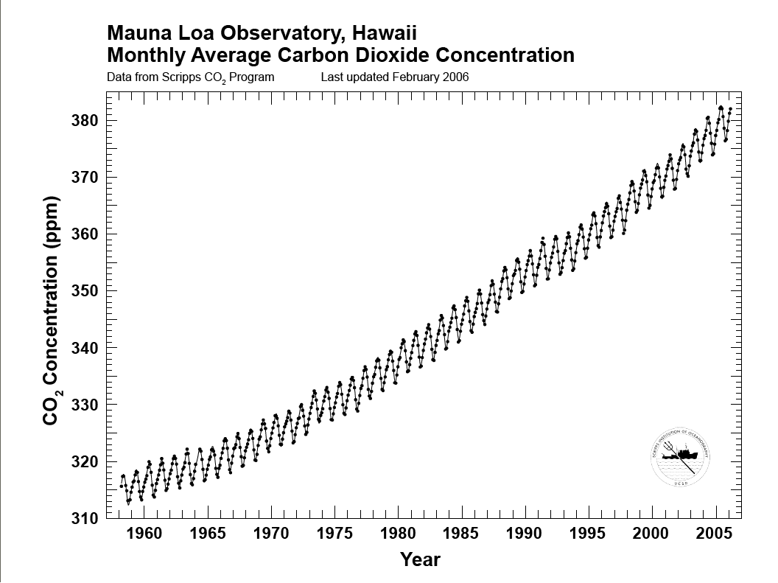
Notes:
http://www.esrl.noaa.gov/gmd/obop/mlo/programs/coop/scripps/co2/co2.html

Slide 7
Anthropogenic Causes of Climate change
Increased levels of greenhouse gasses like carbon dioxide and methane in the atmosphere from the combustion of fossil fuels.
  Electricity production (Coal and natural gas plants)
  Transportation
  Industry
Deforestation: less uptake of carbon dioxide
Mining: releases methane
Food production: very carbon and energy intensive
And more!

Slide 8
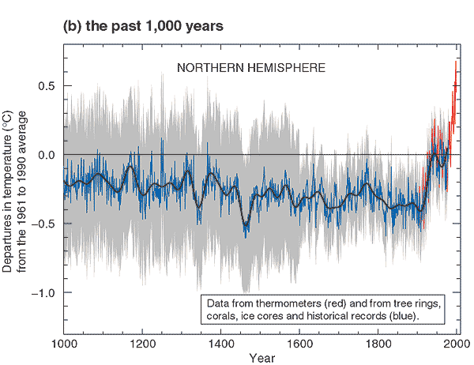
Global Temperatures: Last 1000 Yrs
Northern Hemisphere
Red: thermometers
Blue: Proxy reconstruction
Grey: 95% Confidence Range

Slide 9
What Changed Around 1850?
Industrial Revolution
  Increased burning of fossil fuels
Also, extensive changes in land use began
  the clearing and removal of forests
  These are the two main anthropogenic contributions of atmospheric carbon (Carbon Cycle, next week)

Slide 10
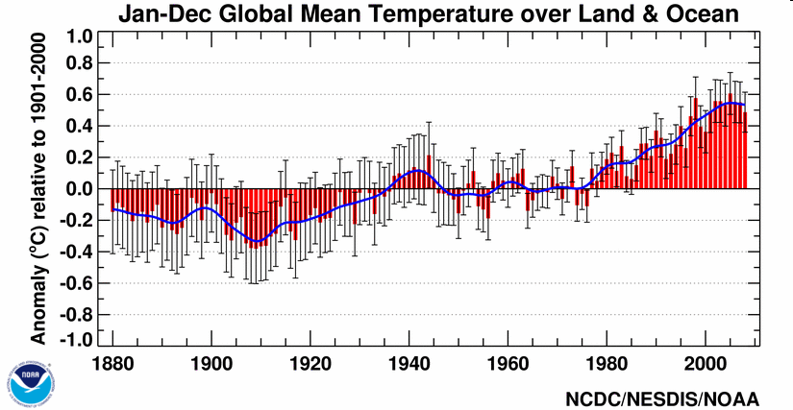
Global Temperatures: Last 130 years
Notes:
http://nsidc.org/data/seaice_index/archives/image_select.html
EVIDENCE
http://oceanworld.tamu.edu/resources/oceanography-book/Images/global-blended-temp.gif
Via
http://oceanworld.tamu.edu/resources/oceanography-book/evidenceforwarming.htm
Global average of sea-surface temperature calculated using Smith and Reynolds techniques, with estimates of errors in the values.
From NOAA National Climate Data Center Climate 2005 Annual Report.

Slide 11
Rate of Temperature Increase has accelerated in recent decades

Slide 12
Spatial View of Recent Warming
1979-2005
Warming has been disproportionately affected land areas (2x)
And higher latitude regions (4x), particularly in winter-spring
Notes:
Observations since 1961 show that the average
temperature of the global ocean has increased to depths
of at least 3000 m and that the ocean has been absorbing
more than 80% of the heat added to the climate system.
Such warming causes seawater to expand, contributing
to sea level rise

Slide 13
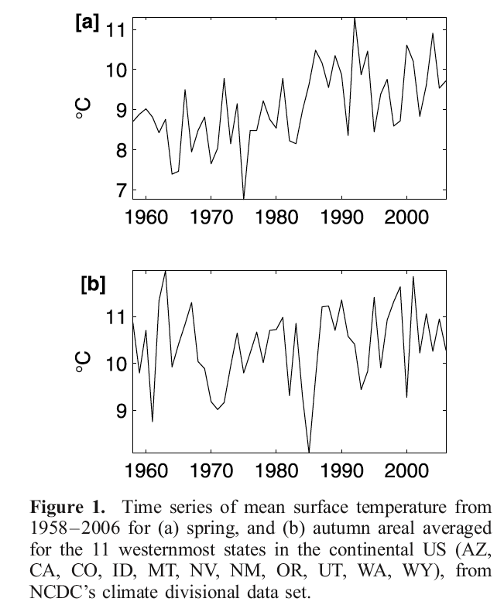
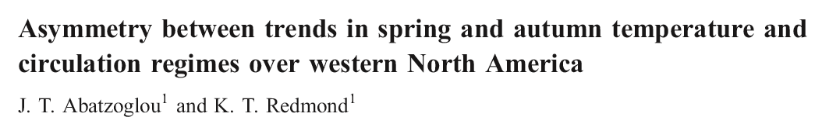
Seasonal Differences in Warming Trends
Spring: +1.5˚C
Autumn: +0.3˚C

Slide 14
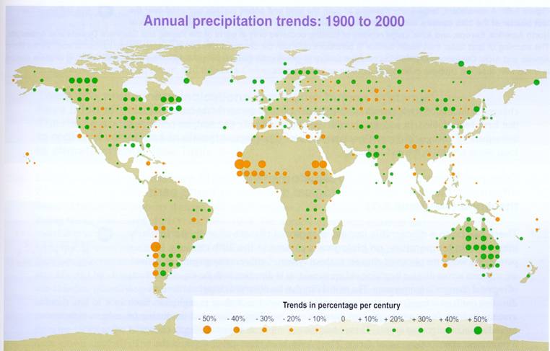
Changes in Precipitation
More Rain
Less Rain
Precipitation has generally increased over land north of
30°N over the period 1900 to 2005 but downward trends
dominate the tropics since the 1970s.
Notes:
Annual Precipitation trends from the Intergovernmental Panel on Climate Change (IPCC): WMO, UNEP
And in the regions where the precipitation is increasing it is characterized by:
More frequent and intense precipitation
Annual precipitation increases due to strong events
More days with precipitation

Slide 15
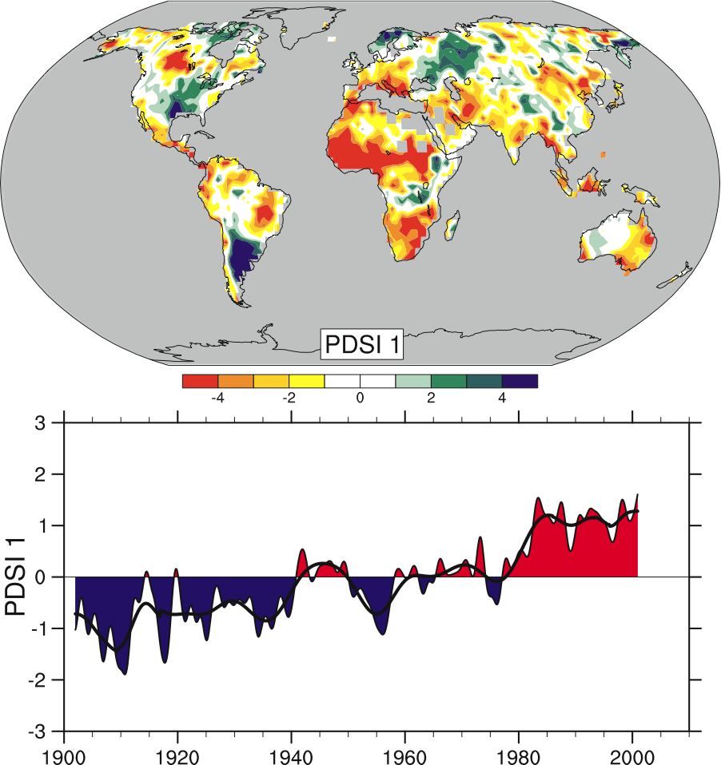
Precipitation Change
Notes:
https://www.ipcc.unibe.ch/publications/wg1-ar4/faq/fig/FAQ-3.2_Fig-1.png
From
https://www.ipcc.unibe.ch/publications/wg1-ar4/faq/wg1_faq-3.2.html
IPCC FAQ: How is precip changing?
The spatial pattern of the monthly Palmer Drought Severity Index (PDSI) for 1900 to 2002. The PDSI is a prominent index of drought and measures the cumulative deficit (relative to local mean conditions) in surface land moisture by incorporating previous precipitation and estimates of moisture drawn into the atmosphere (based on atmospheric temperatures) into a hydrological accounting system.
(+) = wetter than usual

Slide 16
Notes:
https://www.ipcc.unibe.ch/publications/wg1-ar4/faq/fig/FAQ-3.2_Fig-1.png
From
https://www.ipcc.unibe.ch/publications/wg1-ar4/faq/wg1_faq-3.2.html
IPCC FAQ: How is precip changing?
The lower panel shows how the sign and strength of this pattern has changed since 1900. Red and orange areas are drier (wetter) than average and blue and green areas are wetter (drier) than average when the values shown in the lower plot are positive (negative). The smooth black curve shows decadal variations. The time series approximately corresponds to a trend, and this pattern and its variations account for 67% of the linear trend of PDSI from 1900 to 2002 over the global land area. It therefore features widespread increasing African drought, especially in the Sahel, for instance. Note also the wetter areas, especially in eastern North and South America and northern Eurasia. Adapted from Dai et al.

Slide 17
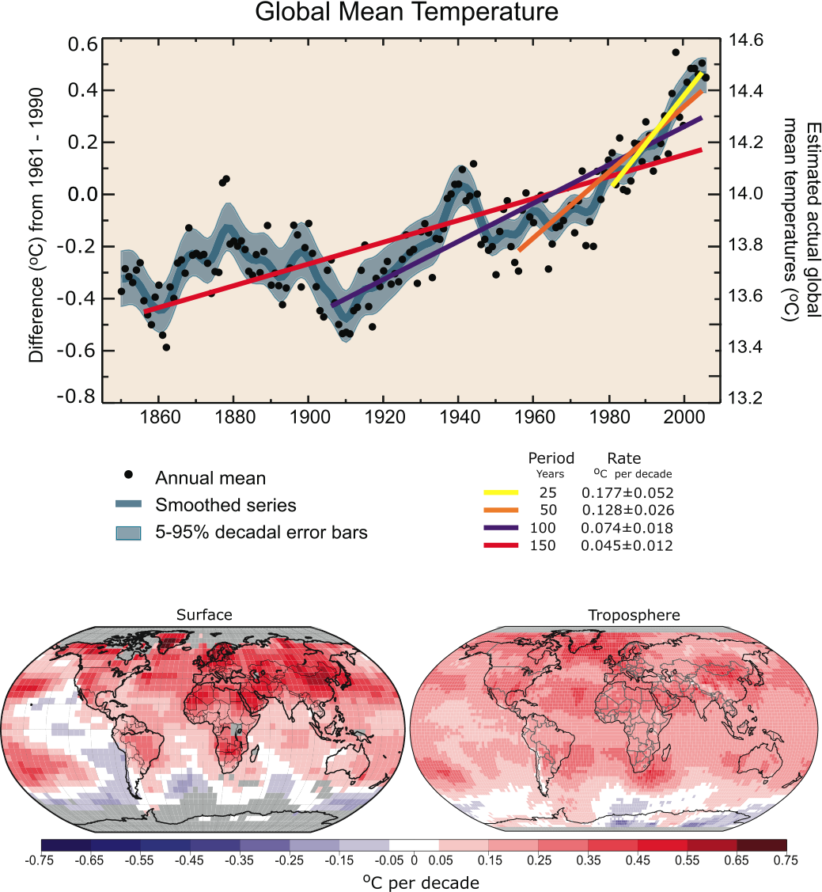
Temperature Change
Notes:
https://www.ipcc.unibe.ch/publications/wg1-ar4/faq/fig/FAQ-3.1_Fig-1.png
From
https://www.ipcc.unibe.ch/publications/wg1-ar4/faq/wg1_faq-3.1.html
IPCC FAQ: How is temp changing?
Patterns of linear global temperature trends from 1979 to 2005 estimated at the surface (left), and for the troposphere (right) from the surface to about 10 km altitude, from satellite records. Grey areas indicate incomplete data. Note the more spatially uniform warming in the satellite tropospheric record while the surface temperature changes more clearly relate to land and ocean.

Slide 18
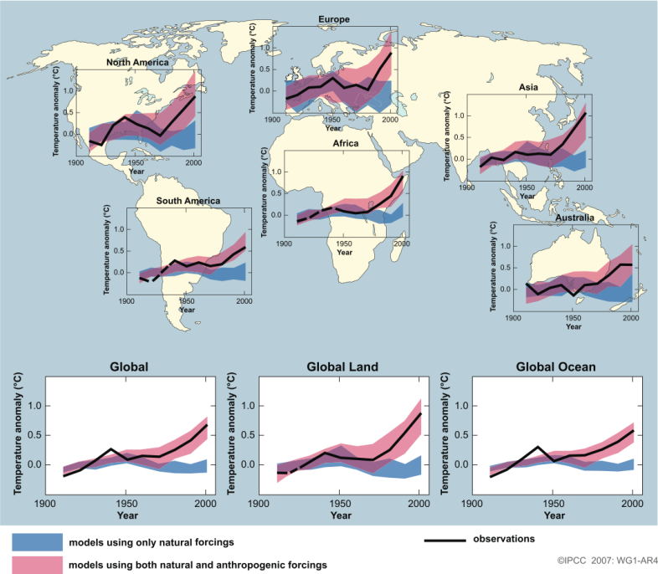
Notes:
https://www.ipcc.unibe.ch/publications/wg1-ar4/faq/fig/FAQ-9.2_Fig-1.png
Via
https://www.ipcc.unibe.ch/publications/wg1-ar4/faq/wg1_faq-9.2.html
IPCC FAQ: Can 20th century warming be explained by natural variability?
Temperature changes relative to the corresponding average for 1901-1950 (°C) from decade to decade from 1906 to 2005 over the Earth’s continents, as well as the entire globe, global land area and the global ocean (lower graphs). The black line indicates observed temperature change, while the coloured bands show the combined range covered by 90% of recent model simulations. Red indicates simulations that include natural and human factors, while blue indicates simulations that include only natural factors. Dashed black lines indicate decades and continental regions for which there are substantially fewer observations. Detailed descriptions of this figure and the methodology used in its production are given in the Supplementary Material, Appendix 9.C.
Blue = models using only natural forcing
Pink = models using natural AND anthropogenic forcings

Slide 19
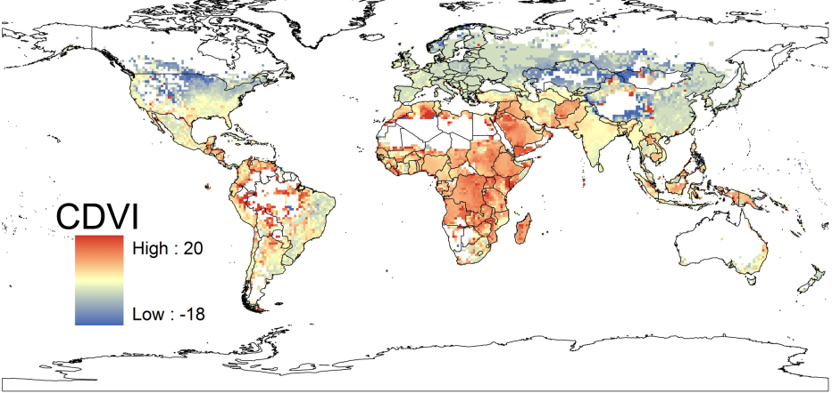
Notes:
IMPACTS
http://www.mcgill.ca/files/_nea/172326_Global%20Vulnerability%20map.pdf
Via
http://cleanet.org/resources/43012.html
This visualization is a map showing the global Climate Demography Vulnerability Index (CDVI) - areas of human population with the highest vulnerability to the impacts of climate change.

Slide 20
So what does this mean?

Slide 21
Impacts of Climate Change
Projected climate in the upcoming century
  Global Temp. will warm at about 0.4 °F per decade
  Changes will be greater than those observed during 20th century
  Estimated increase of global average temperature from 3.3 °F to 7.2 °F
  Sea level rise
  Stronger tropical cyclones
  Increased precipitation in some areas, decreased in others.

Slide 22
More Impacts:
Different/more extreme weather patterns
Changes in wildlife habitats
  Elk/deer moving up in elevation.
  More bark beetles in the Western United States.
  Animals/plants moving towards the poles.
Less freshwater available because of melting glaciers and early snowmelt.
Melting permafrost in Arctic regions – releases Methane a greenhouse gas.

Slide 23
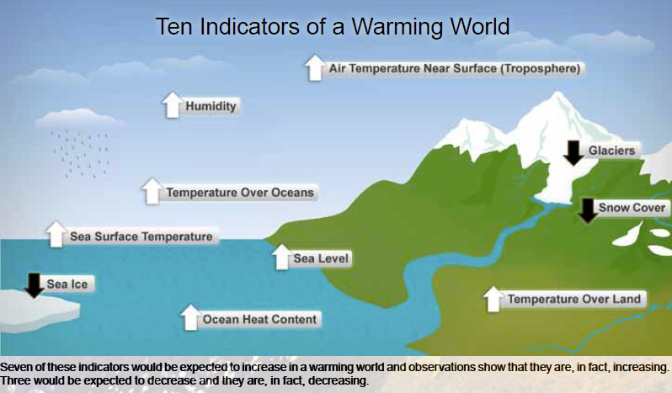
Notes:
10 indicators of a warming world.
http://www.noaanews.noaa.gov/stories2010/images/warmingindicators.jpg
Via
http://www.skepticalscience.com/10-key-climate-indicators-point-to-same-finding-global-warming-is-unmistakable.html
These are all happening → earth is warming/accumulating heat

Slide 24
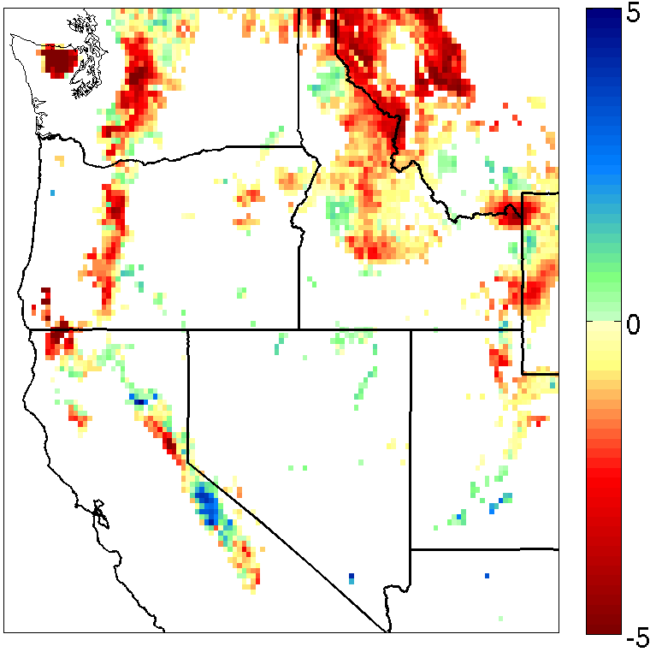
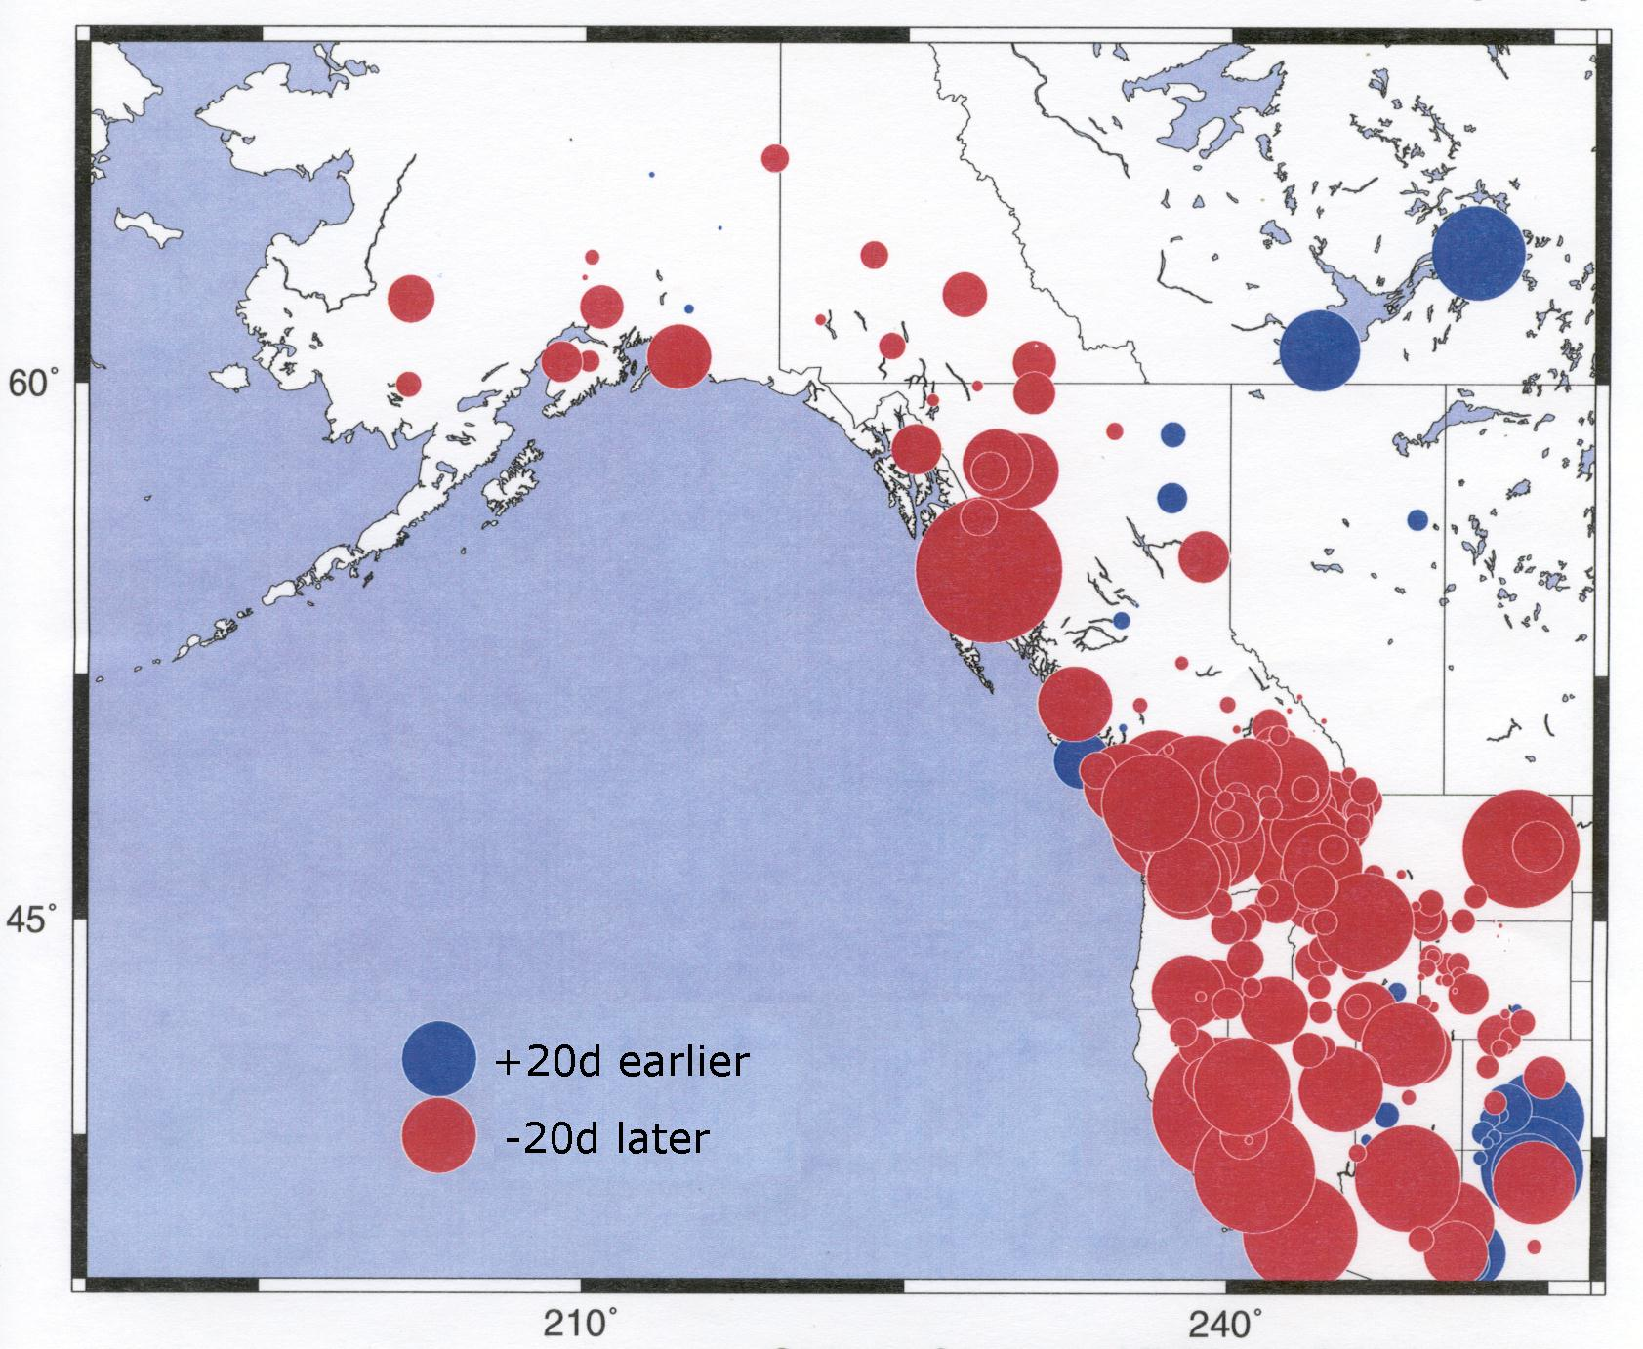
Decline in Western US Snowpack
Linear Trend 1958-2005 (cm/decade)
Timing of peak spring runoff
April 1 snow water equivalent
“how much water is in the snowpack”

Slide 25
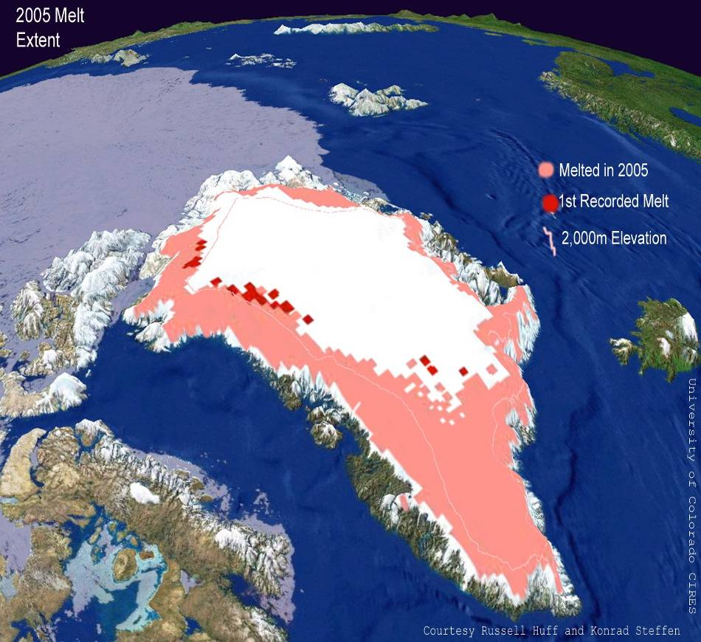
Greenland: Melting
Notes:
Flux of land glacial melt into ocean = 1 mm/yr of sea level rise

Slide 26
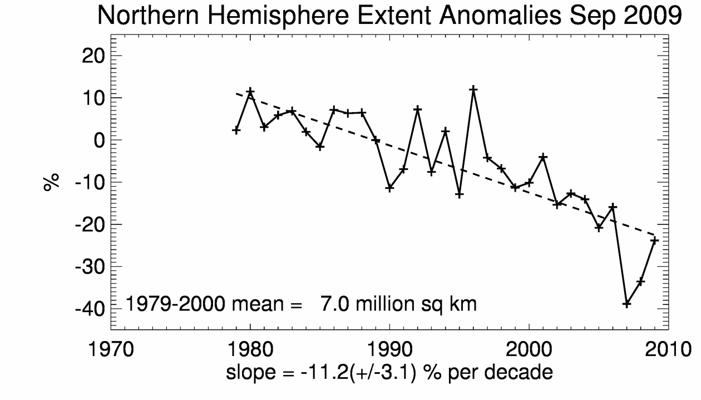
Arctic Sea Ice Coverage

Slide 27
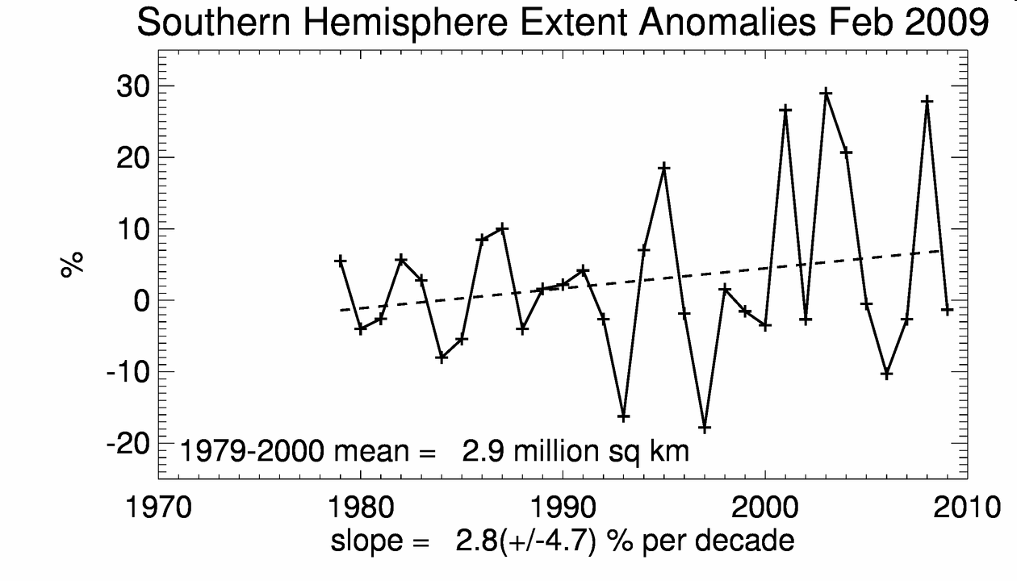
Antarctic Sea Ice Coverage

Slide 28
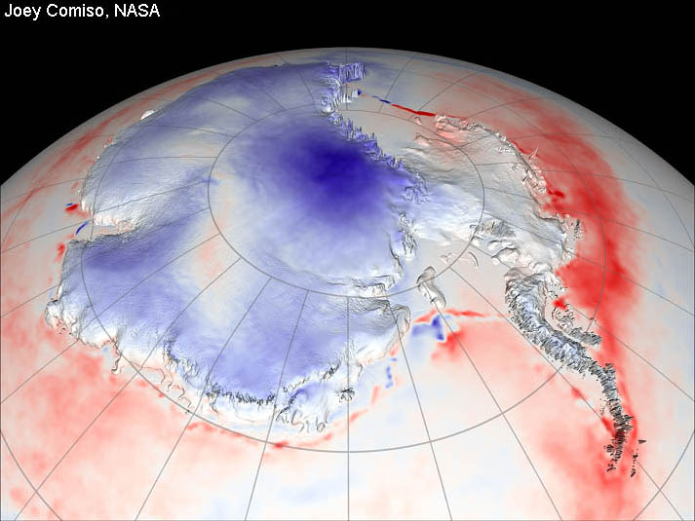
Antarctica: Melting and Thickening
Thickening
due to increased
Precipitation
Growing in East
Melting around
the edges, shrinking in West

Slide 29
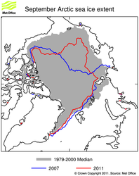
Notes:
http://www.metoffice.gov.uk/media/image/9/5/Arctic_extent_sept2011_branded_normal.png
Via
http://www.metoffice.gov.uk/research/climate/climate-monitoring/oceans-and-sea-ice
Lessening sea-ice extent in the Arctic

Slide 30
Cryosphere
Sea ice is projected to shrink in both the Arctic and Antarctic under all SRES scenarios.
In some projections, arctic late-summer sea ice disappears almost entirely by the latter part of the 21st century…
Continual warming post 21st century may lead to a total melting of the Greenland Ice sheet
  This would raise sea levels by 7 meters!
Scientists believe that IPCC projections on sea level rise and sea-ice dynamics are far too conservative.

Slide 31
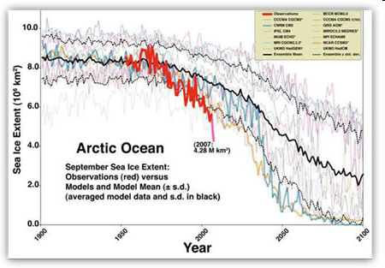
Faster Than Expected

Slide 32
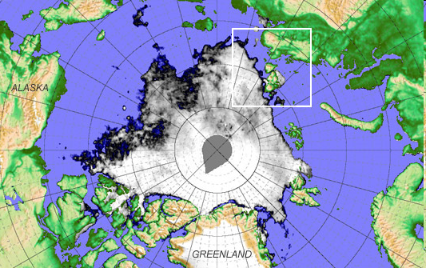
Good News: New Shipping Routes
2007: 2/3 of usual sea-ice north of Bering Strait gone
2008: Northwest Passage and Northern Sea Route opens up!
IPCC reports maybe Arctic will have ice-free summers by 2080

Slide 33
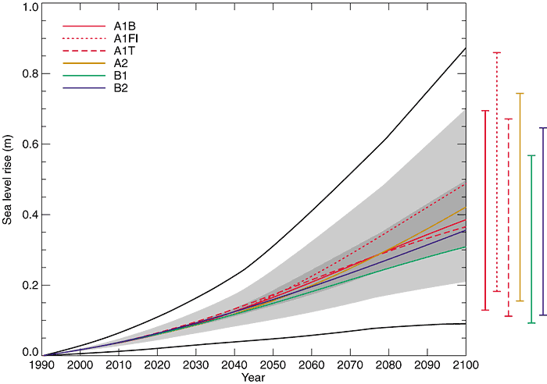
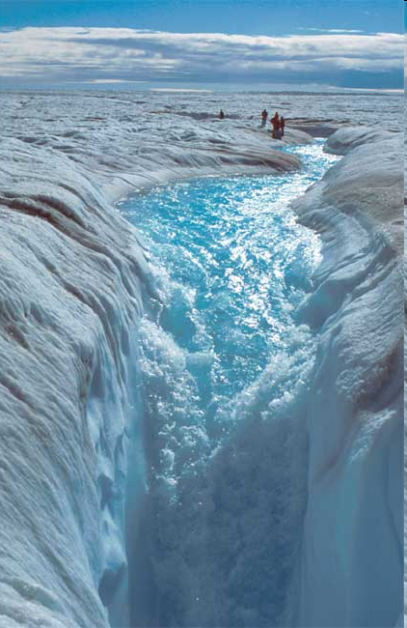
Predictions of future Sea Level
Sea level will continue to rise, between 0.2-0.6 m by 2100
Most of this increase (75%) is due to thermal expansion
IPCC did not include ALL relevant information on glacial meltwater

Slide 34
Sea Level Rise: Thoughts
A sea level rise of 40cm would displace 11% of Indian’s residents ~ climate refugees
Means that Pacific Island nations may be underwater
Sea level rise + stronger storms = higher storm surge and flooding potential
Deep thoughts…
Melting of Greenland (4x size of California) would lead to 7 m increase in sea level
700 million + people live within 9 meters of sea level

Slide 35
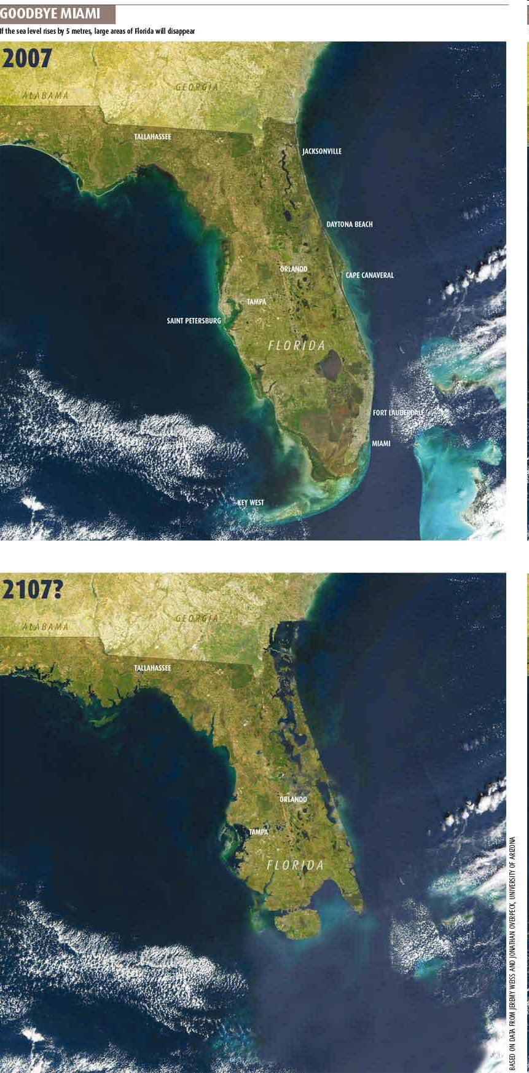
Goodbye Miami
James Hansen
“Business as usual” will eventually melt enough land glaciers to lead to a 25m rise in sea level
Even in this century a 6m rise is possible

Slide 36
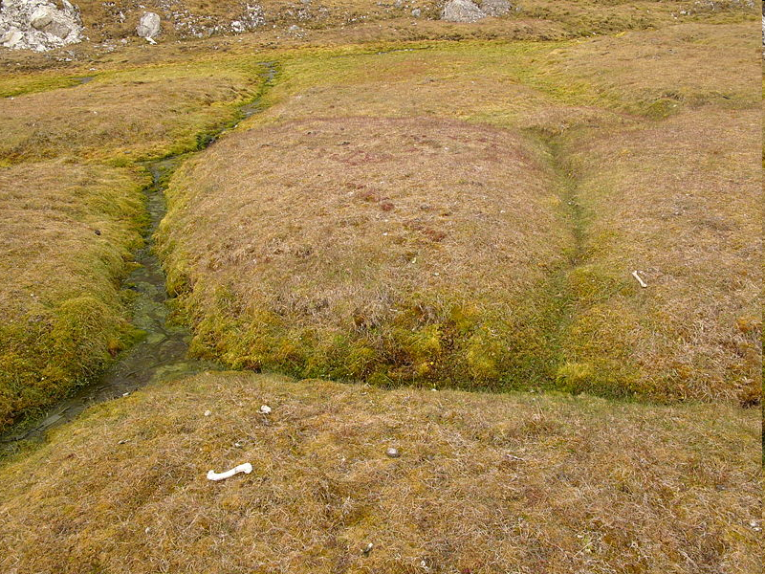
Permafrost: annually frozen soil (below 0C)

Slide 37
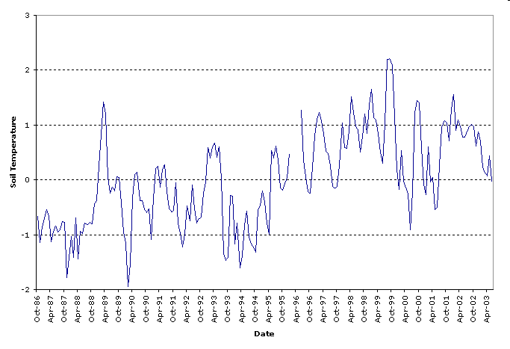
Franklin Bluffs: North Slope Alaska
Permafrost temperature has increased by up to 2°C to 3°C in northern Alaska since the 1980s
Notes:
Soil temperature responds to changes in climate. Changes at great depth (10 m to 200 m) reflect decade-to-century scale climatic variability, because changes in surface conditions take years to propagate through the soil. Soil temperatures closer to the surface, measured by thermistors at about 1 meter depth, are reflective of changes on shorter time scales. The presence or absence of snow and the type and density of vegetation, as well as the composition of the soil itself, can affect the response of soil temperature to changing air temperature. Deep snow and dense vegetation, for example, insulate soil from changes in air temperature.
What happens when average soil temperatures change over time? Areas where the soil remains frozen year to year are areas of permafrost. Permafrost thaws when its temperature rises above zero degrees Celsius, resulting in changes in soil moisture, vegetation, and the ability of the soil to store greenhouse gasses (carbon dioxide and methane). A typical progression would be thawing of permafrost underlying a spruce forest, resulting in the creation of a bog, and loss of the spruce forest. Any man-made structure built on the permafrost would undergo subsidence (Alaska and Siberia are experiencing damage to infrastructure on a widespread area, see Science, 30 Aug 2002, p. 1493). Subsequently the bog might dry out, and be succeeded by woody shrubs.

Slide 38
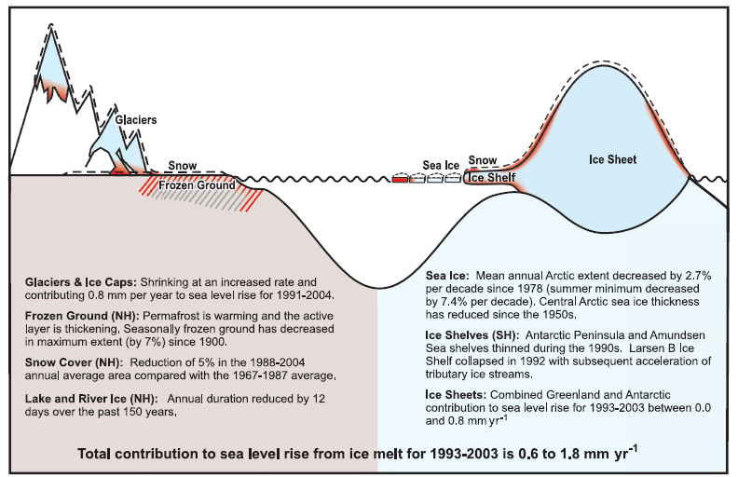

Slide 39
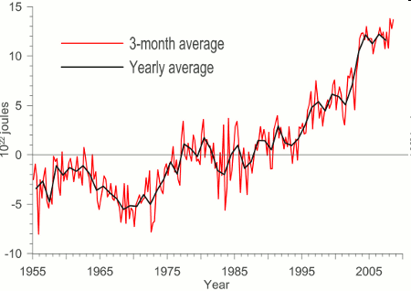
Oceanic Heat Content
Heat content of upper 3000m of ocean has increased
Oceans, the ultimate buffer, have absorbed 80% of heat added to climate system since industrial revolution

Slide 40
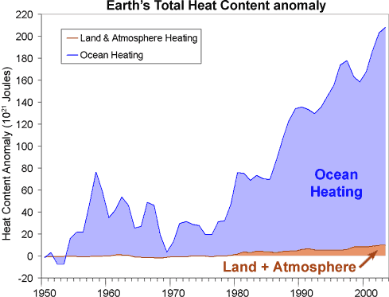
Notes:
http://www.skepticalscience.com/images/Total-Heat-Content.gif
From
http://www.skepticalscience.com/empirical-evidence-for-global-warming.htm
Total Earth Heat Content from 1950 (Murphy 2009). Ocean data taken from Domingues et al 2008.
The planet is accumulating heat
When there is more energy coming in than escaping back out to space, our climate accumulates heat. The planet's total heat build up can be derived by adding up the heat content from the ocean, atmosphere, land and ice (Murphy 2009). Ocean heat content was determined down to 3000 metres deep. Atmospheric heat content was calculated from the surface temperature record and heat capacity of the troposphere. Land and ice heat content (eg - the energy required to melt ice) were also included.
From 1970 to 2003, the planet has been accumulating heat at a rate of 190,260 gigawatts with the vast majority of the energy going into the oceans. Considering a typical nuclear power plant has an output of 1 gigawatt, imagine 190,000 nuclear power plants pouring their energy output directly into our oceans. What about after 2003? A map of of ocean heat from 2003 to 2008 was constructed from ocean heat measurements down to 2000 metres deep (von Schuckmann 2009). Globally, the oceans have continued to accumulate heat to the end of 2008 at a rate of 0.77 ± 0.11 Wm, consistent with other determinations of the planet's energy imbalance (Hansen 2005, Trenberth 2009). The planet continues to accumulate heat.
(paragraphs taken from http://www.skepticalscience.com/empirical-evidence-for-global-warming.htm
)

Slide 41
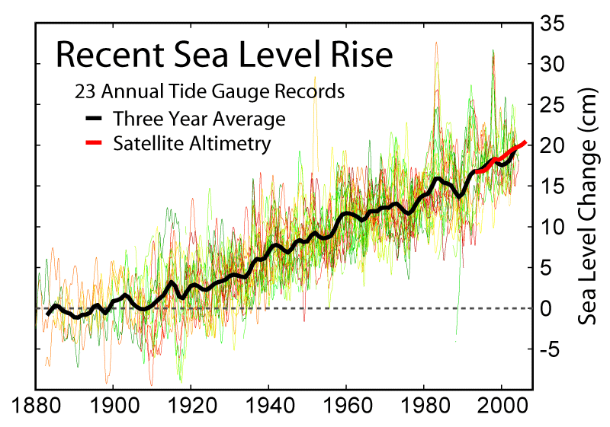
Sea-Level at San Francisco
Sea Level rise of 1-2mm/year

Slide 42
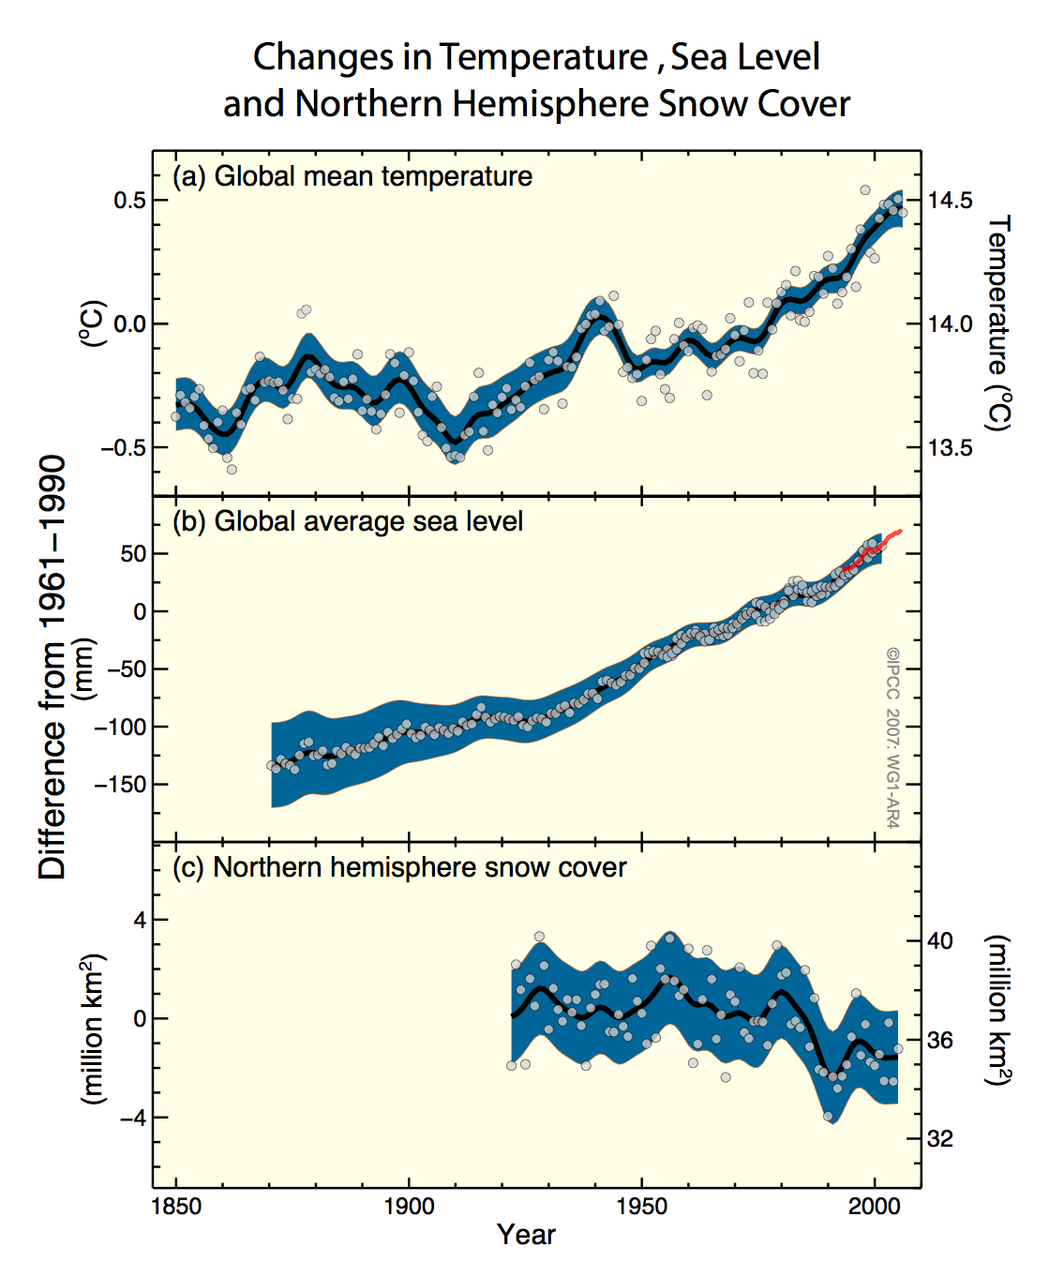
Warming is Unequivocal
Rising atmospheric temperature
Rising sea level
Reductions in NH snow cover
And oceans..
And upper atmosphere….

Slide 43
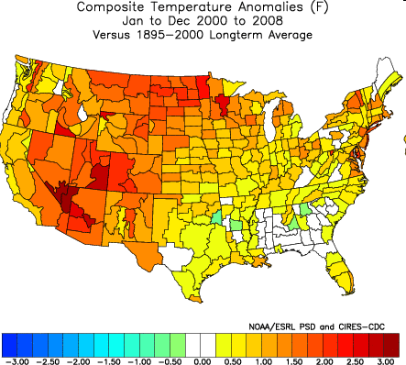
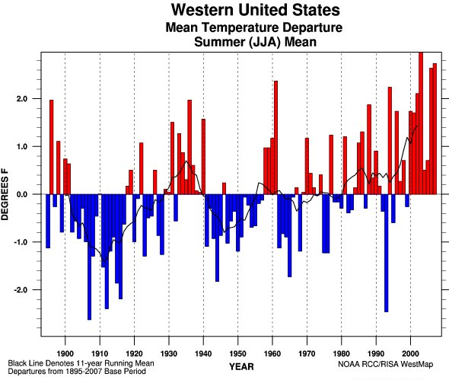
How the West Has Warmed
…and overachieved…
Notes:
The western US has warmed at a rate nearly 70% greater than that of the globe as a whole, this of course in a region that relies heavily on snowpack for their water supplies. Furthermore the rate of temperature increase across the West shows a relationship with elevation such that higher elevation regions have warmed faster than lower elevation regions.

Slide 44
Idaho and Pacific Northwest
Very Likely/Certain
  Warmer Temperatures
  Increased Frequency and Intensity of Heat Waves
  Decrease in snow at lower-to-mid elevations
  Rain on Snow events for mid-elevation watersheds.
Likely
  Increase in winter precipitation, decrease in summer
  Increased Intensity of heaviest precipitation
  Increased length of fire season

Slide 45
Precipitation
Likely
Increase in winter precipitation
Decrease in summer precipitation
Increase in Intensity of heaviest precipitation
Highly Likely
Decrease in snowfall
Rain on Snow events for mid-elevation watersheds

Slide 46
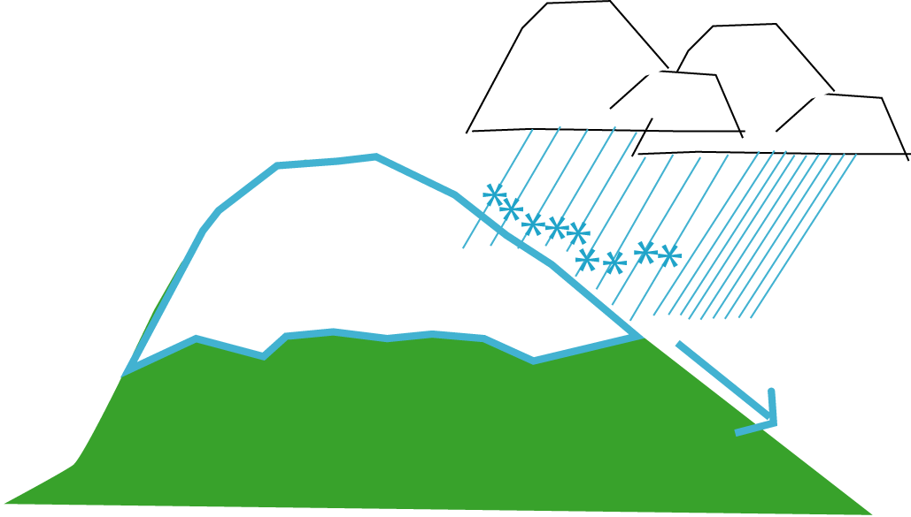
20th Century Precipitation Maker
Majority of mountain precip stored in snow pack, no immediate impact for runoff

Slide 47
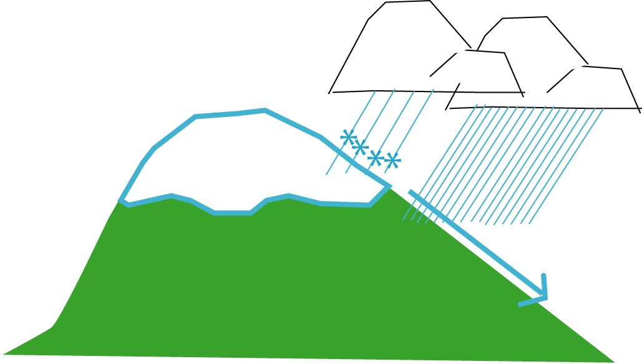
21st Century Precipitation Maker
Significant reduction in precip stored in snow pack, immediate impact for runoff
runoff
“Climate Change” Flood
Average Snow level increase of 1-2k ft
Increased atmospheric H₂O = increased heavy events

Slide 48
Historical and Projected 21st Century Flows for the A1b Scenario
Increased Winter Flows
Yakima River
Decreased Spring/Summer Flows

Slide 49
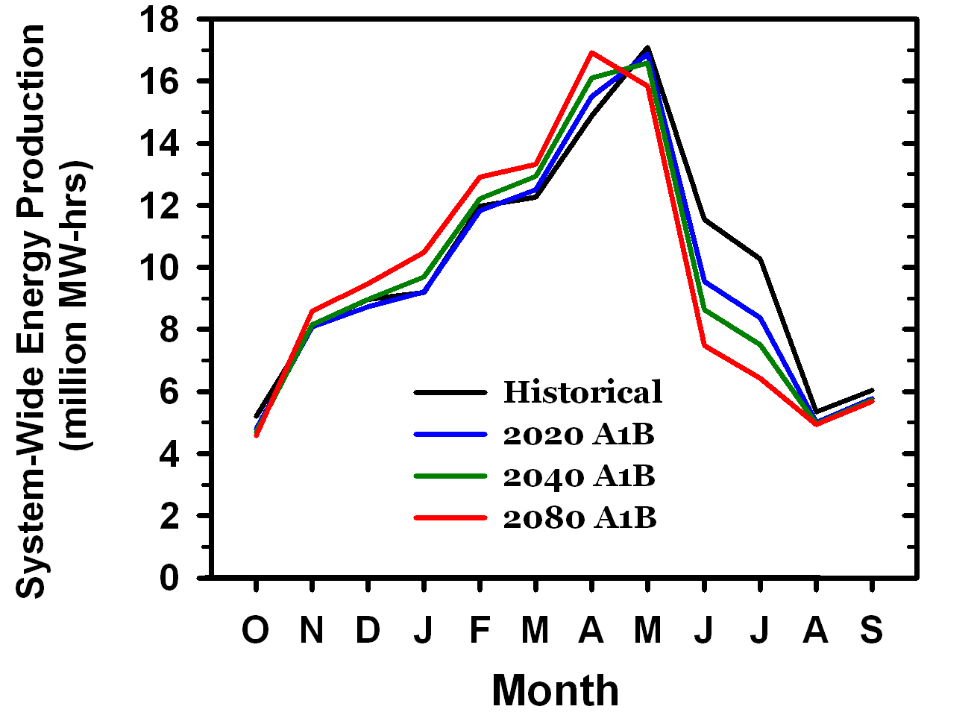
Hydropower Production
Winter production is projected to increase slightly
Summer energy production is projected to decline by 10-40%. Summer cooling demands may increase by 400%
Hamlet et al. 2009
Notes:
49
Figure 3. Simulated temperature (change, top panel) and precipitation (% change, bottom panel) for the 20th and 21st Century climate model simulations. The black curve for each panel is the weighted average of all models during the 20th Century. The colored areas indicate the range (5th to 95th percentile) for each year in the 21st Century. All changes are relative to 1970-1999 averages.

Slide 50
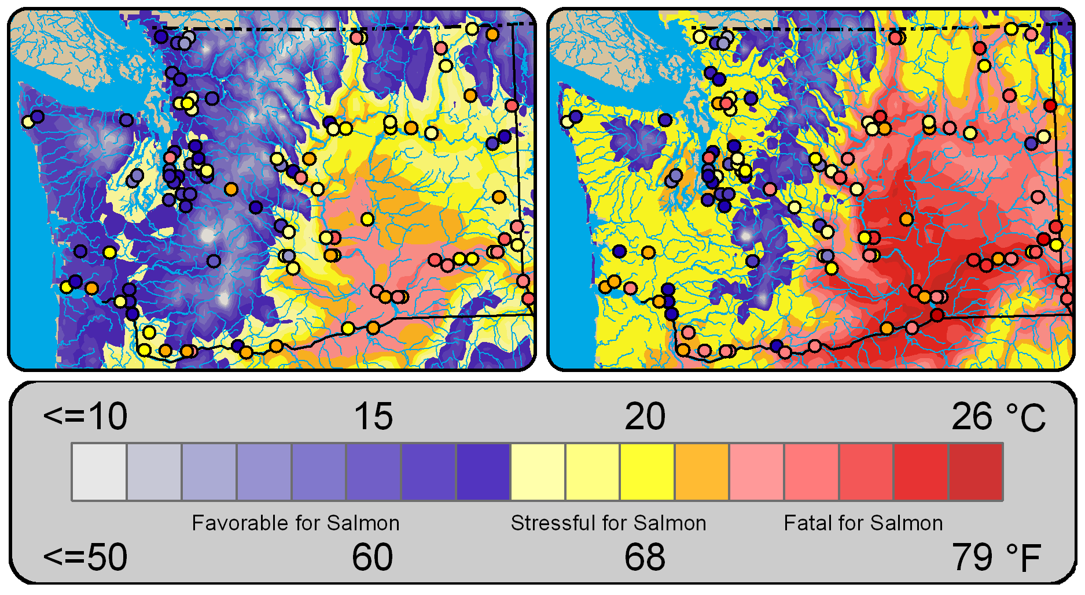
Salmon and Ecosystems
Historical (1970-1999)
2040s medium (A1B)
Rising stream temperature will reduce the quality and quantity of freshwater salmon habitat substantially.
Duration of thermal migration barriers and extreme thermal stress (temperatures exceed 70°F) are predicted to quadruple by the 2080s.
Mantua et al. 2009
Notes:
50
Figure 3. Simulated temperature (change, top panel) and precipitation (% change, bottom panel) for the 20th and 21st Century climate model simulations. The black curve for each panel is the weighted average of all models during the 20th Century. The colored areas indicate the range (5th to 95th percentile) for each year in the 21st Century. All changes are relative to 1970-1999 averages.

Slide 51
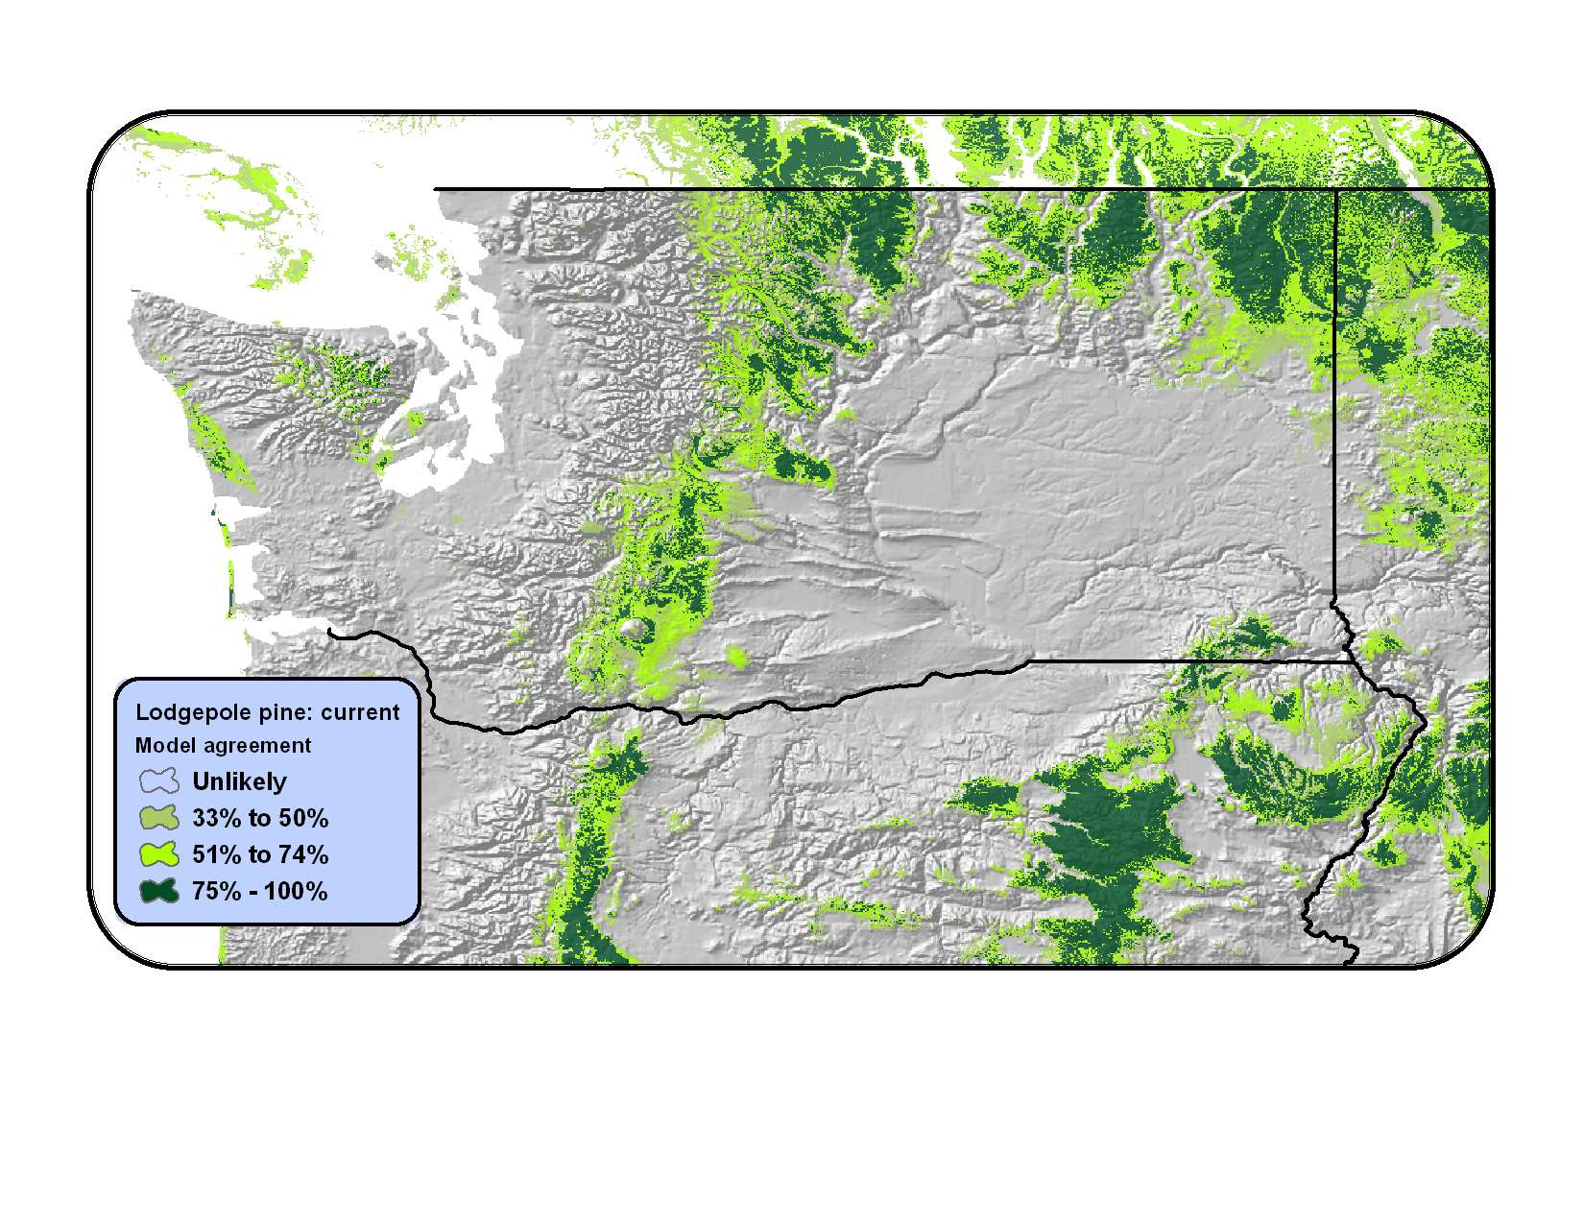
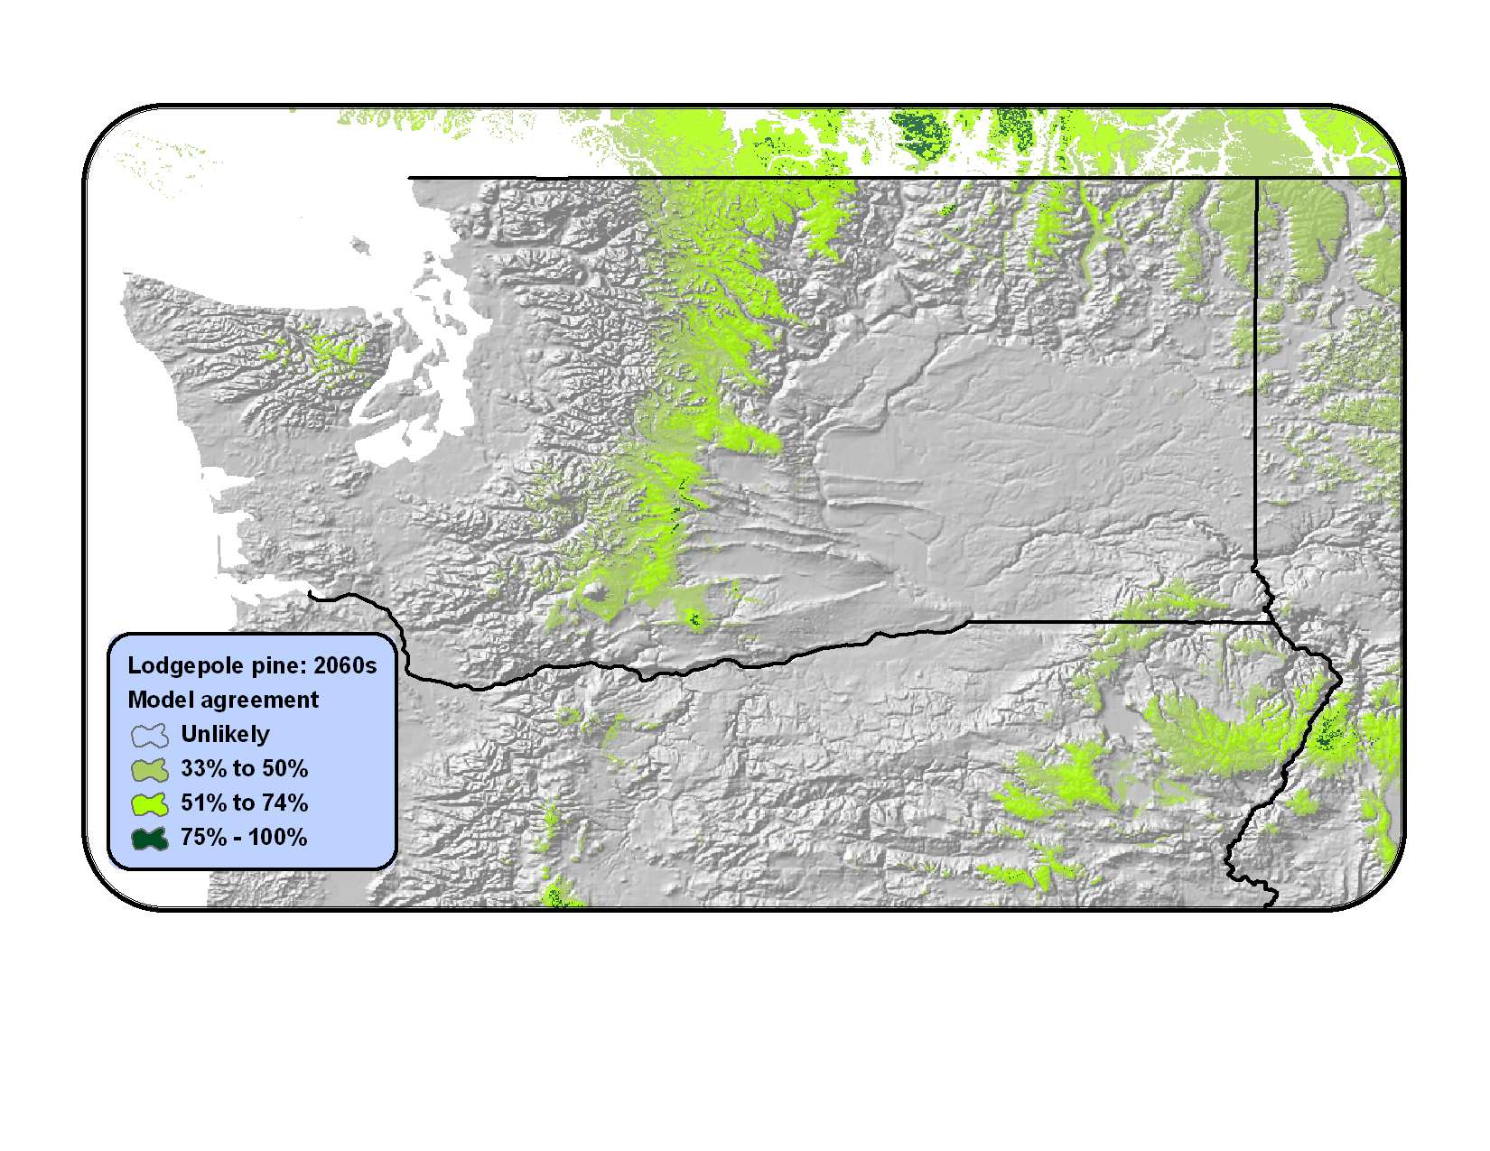
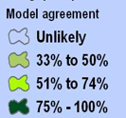
Forests
Current
2060s
Changes in the potential suitable range of lodgepole pine
(Data: Rehfeldt et al. 2006, multiple IPCC scenarios).
Littell et al. 2009
Notes:
51
Figure 11. Changes in areas of potential pine species’ ranges (top panel) and severely water limited forest (bottom panel) in Washington. Areas of orange and yellow in the top panel indicate areas where one or more pines may have difficult re-establishing after disturbance because the climate has exceeded their tolerances (Data: Rehfeldt et al. 2006, multiple IPCC scenarios). Hydrologic modeling suggests many areas on the northern edge of the Columbia basin will become severely water limited (bottom, scenario A1B)

Slide 52
Agricultural Impacts
3+ billion dollar business, vast majority relies of heavy irrigation
Pros (for some crops)
Higher CO2 stimulate plant growth/water efficiency
Increased growing season length
New crops (vineyards)
Cons
Increased irrigation demands
Extreme temperatures endanger state “fruit” suitability
Increases in summer temperatures impact dairy industry
This means that agriculture will be more expensive

Slide 53
Economic Impacts
Water:
Decreased supply + Increased demands = classic formula for increased prices and shortages.
Energy:
Dramatic increase in summer cooling costs (far exceeding winter heating costs) + Decreased hydroelectric output
Food:
Agricultural losses + water losses + energy
Infrastructure:
Increase Large Fire + Increased extreme events

Slide 54
Things to Remember
Observational evidence shows irrefutable warming of the climate system over the past century.
The rate of global temperature increase has increased in recent decades
Distribution of temperature increases are NOT uniform spatially: where is it warmest fastest? And Why?
Cryospheric evidence supports numerous lines of observational evidence to support the warming signal
Precipitation shows some signs of increases in high latitudes, decreases in subtropical regions.

Slide 55
Sources
Dr. Crystal Kolden
Dr. John Abatzoglou (http://webpages.uidaho.edu/jabatzoglou/)
More information:
www.westernclimateinitiative.org/
Icenetmatrix.com
http://www.atmos.washington.edu/mm5rt/
http://www.wrcc.dri.edu/research/jtwrcc/idaho-mon/
http://www.wrcc.dri.edu/monitor/WWDT/
http://www.cefa.dri.edu/Westmap/
http://www.cpc.ncep.noaa.gov/products/predictions/90day/

