Slide 1
Integrating Climate Education Resources into your Courses
Crystal A. Kolden
Department of Geography
University of Idaho

Slide 2
Who am I? Why am I here?
Assistant Professor of Geography at UI (hired under recent EPSCoR Infrastructure grant)
Lead for Intro Physical Geography labs and lab manual re-write over past 3 years
Also taught Physical Geography and Geology courses at Nevada-Reno and Truckee Meadows Community College
Research: Climate change impacts on human-environment, integrating climate information into decision-making

Slide 3
NASA ICE Net Project
Intermountain Climate Education Network Goals:
Develop place-based climate science content
Deliver climate science content and resources
Help K12 teachers and CC instructors integrate climate science into their curriculum
Climate Education Products:
4 place-based learning activity modules for K12
Lab activities for lower-level college courses
ICE Net Climate Science Matrix
Ready-to-teach power points of climate concepts and resources

Slide 4
Goals today
Describe climate science integration process in UI courses
Review the ICE Net products relevant to higher education
Highlight some additional UI-based and other resources for climate science and data
Meet with individual instructors to assess their needs and brainstorm approaches

Slide 5
Idaho EPSCoR’s Goals
Increase amount of climate science being taught in Idaho community colleges and 4-year universities
Increase number of students receiving climate science education
Participation stipend: $500 for 2 meetings with me and documented integration into syllabi/course (w/ # students reached)

Slide 6
Climate Science Education at UI
Geography department had 3 new hires between Aug 2009 and Aug 2011
John Abatzoglou – Climatologist
Tim Frazier – Climate change hazards
New climate change minor beginning Fall 2011
New courses: 3xx/5xx Global Climate Change, 401 Climatology, 405/505 Water Resources in a Changing Climate, 412/512 Applied Meteorology and Climatology, 435/535 Climate Change Mitigation, 455 Societal Resilience and Adaptation to Climate Change
Outside of Geography: courses in Natural Resources, Agriculture colleges increase climate change content

Slide 7
Rest of state
30 hires on EPSCoR grant around state (BSU, ISU, UI)
All researchers focusing on some aspect of climate change
Several large research and education grants related to climate change in last 5 years
Numerous courses at universities integrating climate change

Slide 8
What this means for transfer students
New k12 Next Generation Science Standard include climate change
Courses at universities incorporating climate science and change
Community colleges: opportunity to help increase exposure

Slide 9
Resource I: ICE Net products
Climate Science Matrix
Plug-n-play power points for instructors
Lower-level classroom activities and labs that can be adapted locally

Slide 10
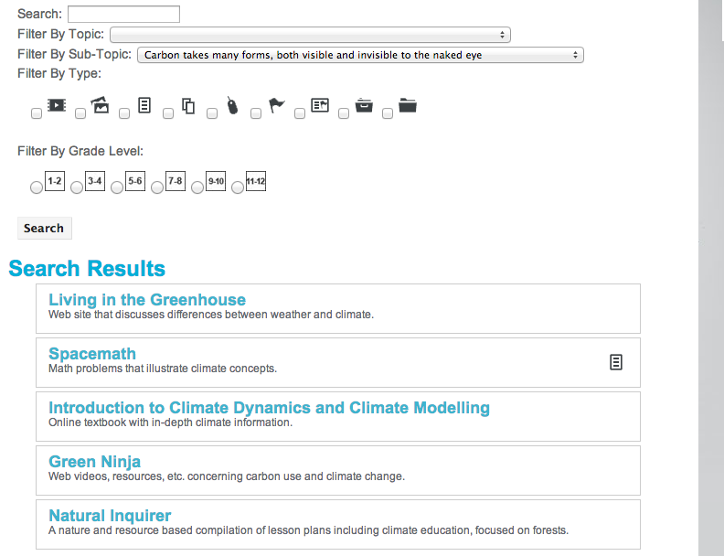
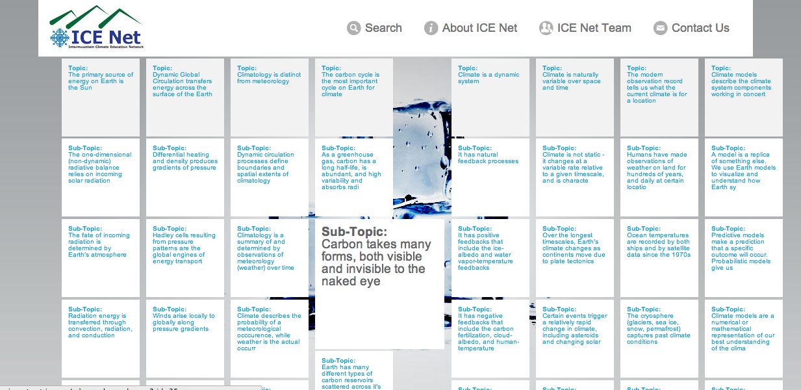
Climate Science Matrix www.icenetmatrix.com

Slide 11
Lecture materials
Climate and climate change records
Climate forcing and models
Anthropogenic climate change and impacts
Climate Mitigation and Adaptation
-Derived from a variety of cited sources, includes material from UI scientists

Slide 12
Classroom/Lab Activities
Global Climate (records and proxies)
Hydrologic systems, snowcover, and groundwater (SWE, water storage)
Climate and Phenology (NPN, remote sensing)
Riparian Ecosystems (water quality, DO)
Carbon in the Forest (carbon accounting)
Can be adapted, tested in GEOG 100

Slide 13
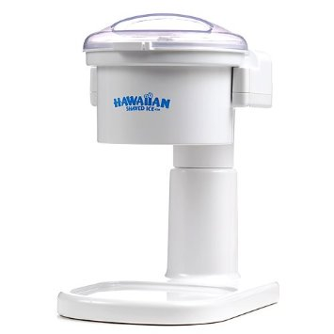

Slide 14
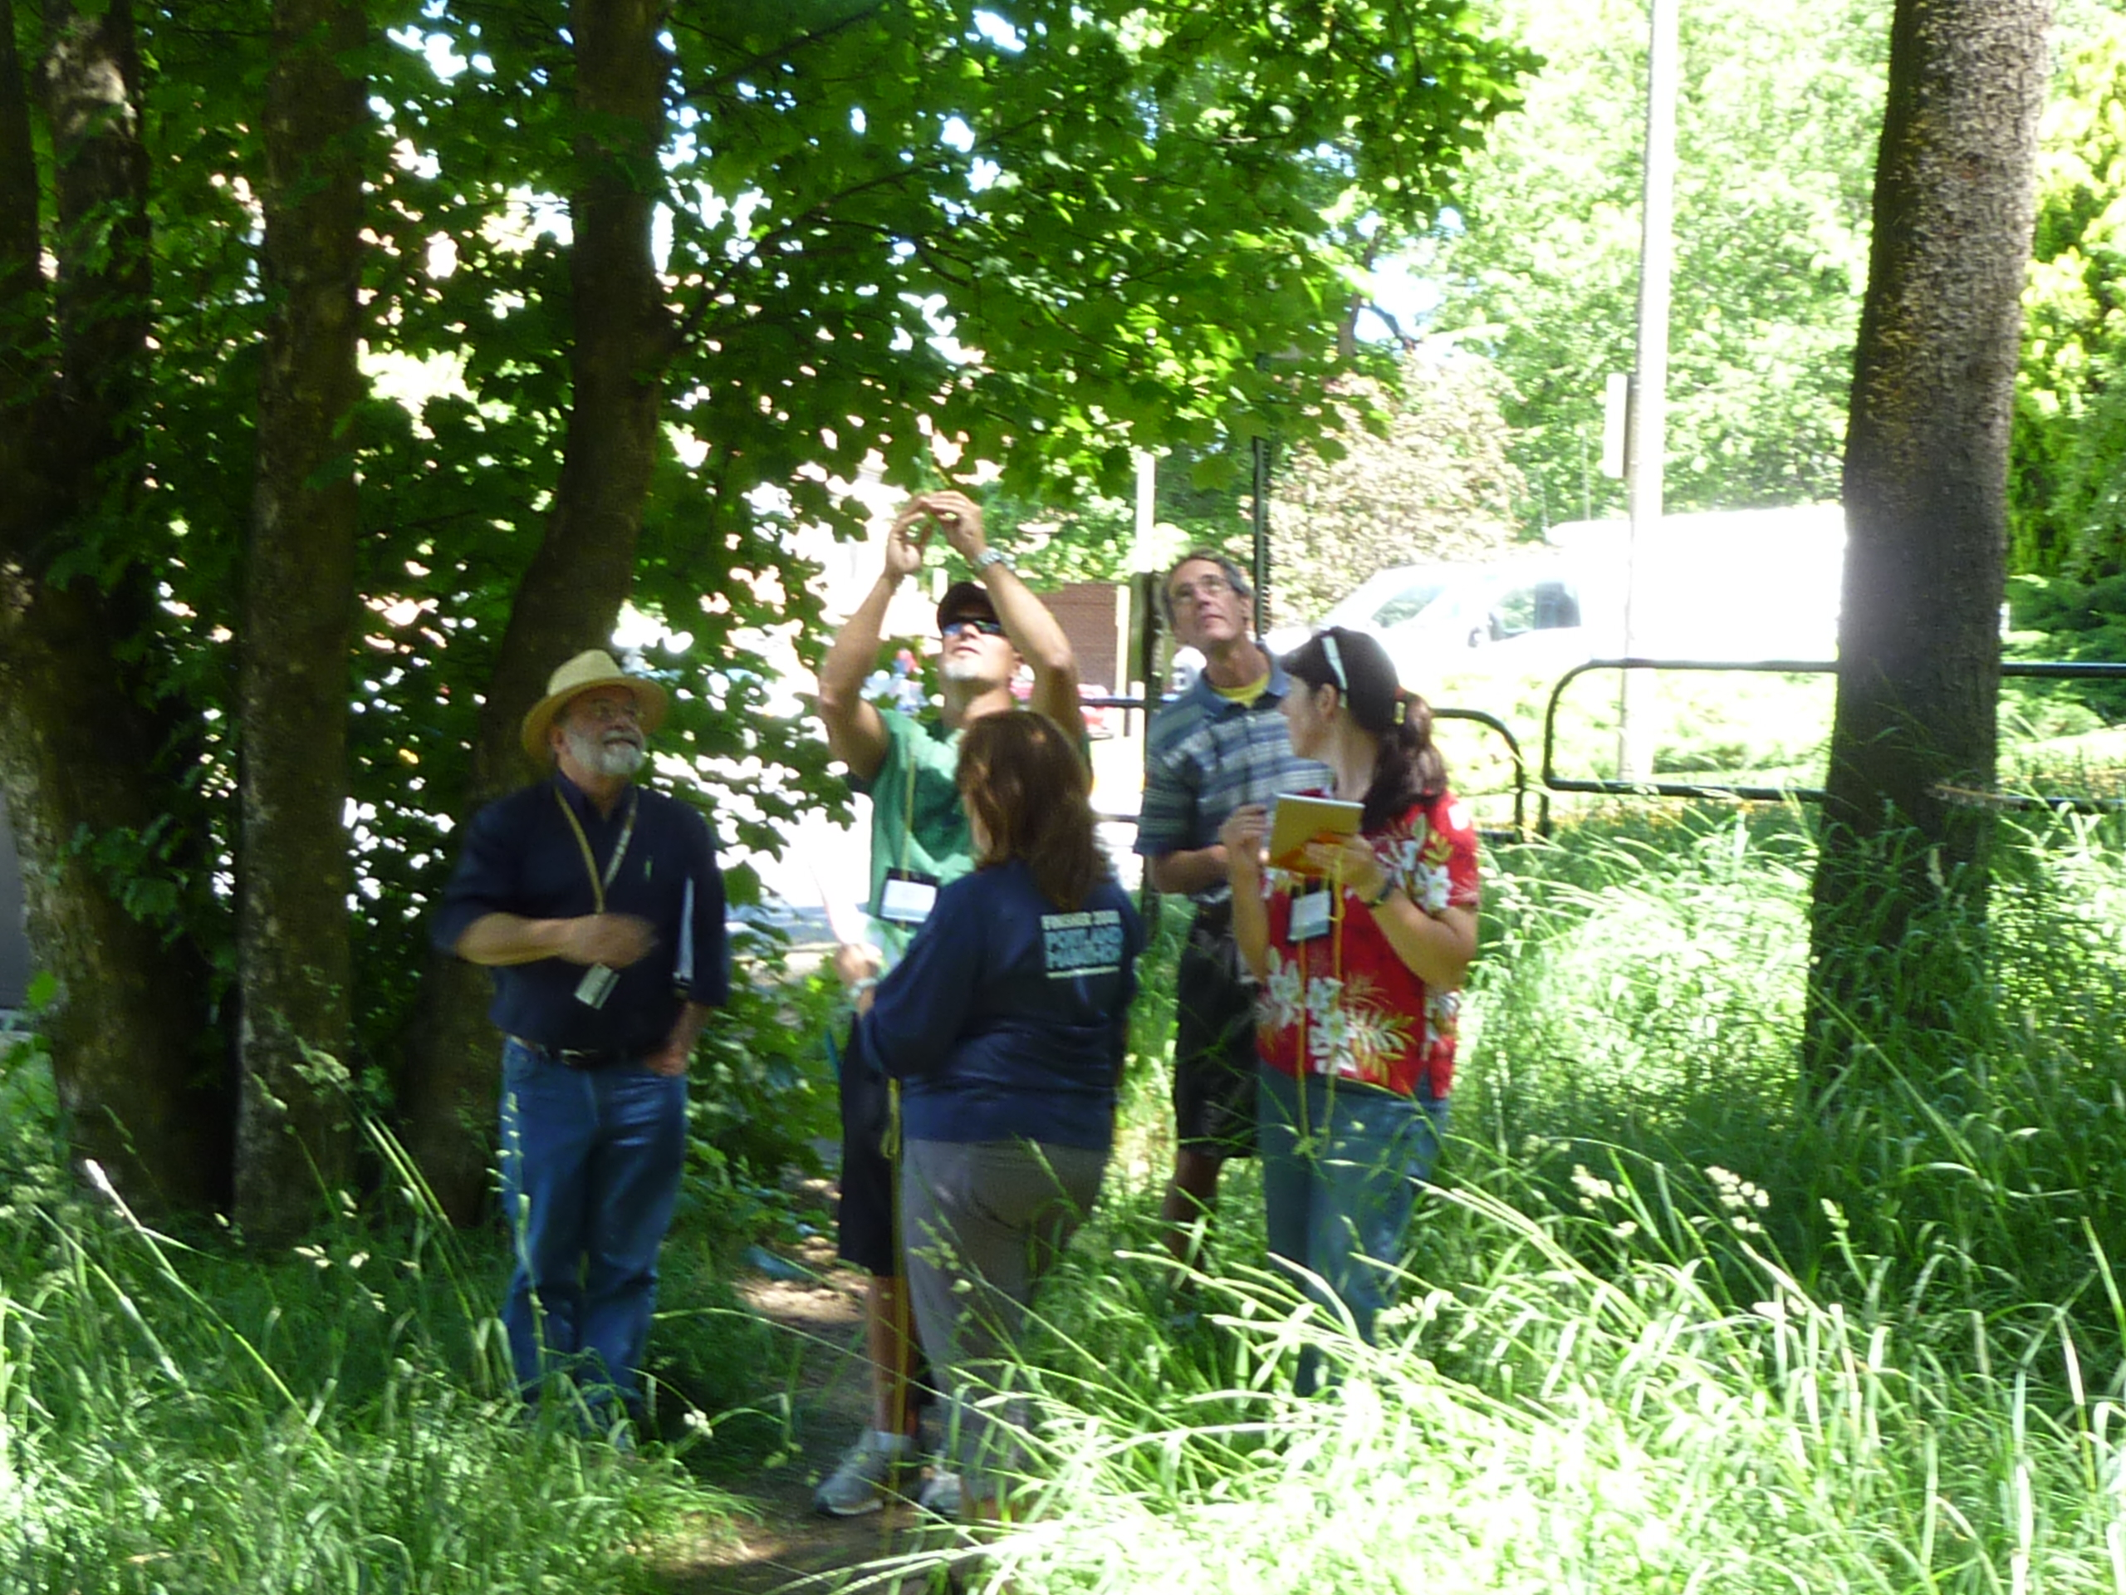

Slide 15
Other projects and resources at UI

Slide 16
Insideidaho.org
Geospatial data for state
Some tools to access data
Climate models outputs and downscaled projections for western US
In-progress: GIS and web-based tools for accessing and manipulating climate data

Slide 17
Other projects and resources at UI

Slide 18
www.reacchpna.org
Regional Approaches to Climate Change focuses on climate and agriculture
Research on GHG uptake, drought, crop yields, insects, etc.
Focused on wheat (Columbia Basin) but good agriculture resources
Has an education component

Slide 19
Other projects and resources at UI

Slide 20
Dr. John Abatzoglou at UI
Inland NW climate tracker tool
Westwide Drought tracker tool
Links to numerous great resources
Climate Blog
Websites for courses taught
http://webpages.uidaho.edu/jabatzoglou/index.html

Slide 21
Integrating into your courses
Spectrum: just want to add a few things TO want to ramp up big time
Biology, Chemistry, Geography, Geology, Environmental Science, Physics, Health Sciences, Engineering, ???
How to “add in” – what resources

Slide 22
Biology
Evolution: Species extinctions and development
Physiological adaptation strategies and opportunists
Species vulnerability and tolerances
Biogeochemical cycles
Photosynthesis: sensitivity to CO_{2 and} water availability

Slide 23
Geology
Time scales of change
Past climate change vs present: how the rates of change are different
Paleorecords recorded in rocks
Stored carbon in different geologic materials/strata (fossil fuels)
Geo-engineering: forced sequestration

Slide 24
Health Sciences
Past relationships between epidemics and climatic conditions
Extreme events – heat waves, drought, cold events, food shortages – impact health
Human tolerance ranges
Socially and economically vulnerable populations
Diseases, vectors of spread, rates of mutation

Slide 25
Goals for meeting with me
Identify what classes you might integrate into
Identify specific tie-in points within course
Brainstorm science resources and connections
Brainstorm classroom activities/labs/assignments

Slide 26
Available times today
11
11:30
12:30
1
1:30
2:30
3
Also available by phone or video chat next week (ckolden@uidaho.edu)
Resources @ www.pyrogeographer.com

